Slide 1
HR -EMPLOYEES DISTRIBUTION REPORT

Slide 2
TABLE OF CONTENTS
PROJECT OBJECTIVE
SQL DATA CLEANING
SQL DATA ANALYSIS
SQL FILE LINK
VISUALIZATION USING POWER BI
KEY INSIGHTS
CONCLUSION

Slide 3
Project Objective
Clean HR dataset using SQL.
Analyze employee trends and workforce distribution using SQL.
Build Power BI dashboards for business insights.
Track turnover, demographics, and employee growth.

Slide 4
SQL DATA CLEANING
Converted inconsistent date formats using STR_TO_DATE().
Handled null and duplicate values.
Renamed columns for consistency.
Created calculated fields like Age and Full Name.

Slide 5
SQL DATA ANALYSIS
AGE BREAKDOWN OF EMPLOYEES IN THE COMPANY.
ETHNICITY BREAKDOWN OF EMPLOYEES IN THE COMPANY.
AGE DISTRIBUTION OF EMPLOYEES IN THE COMPANY.
EMPLOYEES WORKING IN HEADQUARTERS VERSUS REMOTE LOCATIONS.
AVERAGE LENGH OF EMPLOYEES WORKING IN THE COMPANY BEFORE TERMINATION.
DISTRIBUTION OF JOB TITLE ACROSS THE COMPANY .
TURNOVER RATE OF EMPLOYEES IN THE COMPANY.
DISTRIBUTION OF EMPLOYEES BY STATE.
CHANGE OF EMPLOYEES COUNT OVER TIME BASED ON HIRE NAD TERM DATE.
TENURE DISTRIBUTION FOR EACH DEPARTMENT.
GENDER DISTRIBUTION ACROSS VARIOUS DEPARTMENTS.

Slide 6
SQL FILE LINK

Slide 7
VISUALIZATION -POWER BI

Slide 8
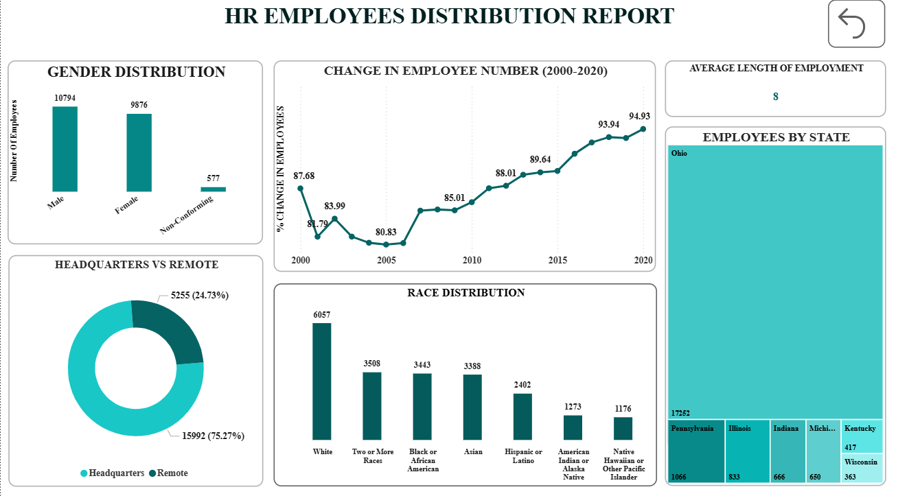

Slide 9
Employee Growth Trend (2000–2020)
Employee growth showed a consistent upward trend after 2006.
Workforce growth percentage increased from nearly 80% to around 95% by 2020.
Significant growth acceleration is visible after 2015.
Gender Distribution
Male employees (10,794) slightly outnumber female employees (9,876).
Non-conforming employees represent a very small portion of the workforce (577).
Race Distribution
White employees form the largest workforce segment (6,057).
Black or African American, Asian, and Two or More Races categories show balanced diversity representation.
Native Hawaiian or Other Pacific Islander category has the lowest employee count

Slide 10
.
Headquarters vs Remote Employees
Remote employees dominate the workforce with 75.27%.
Headquarters employees account for only 24.73%.
Shows the organization strongly supports remote work culture.
Employees by State
Ohio has the highest employee concentration with 17,252 employees.
Pennsylvania and Illinois are the next major employee hubs.
Workforce distribution is heavily concentrated in a few key states.

Slide 11
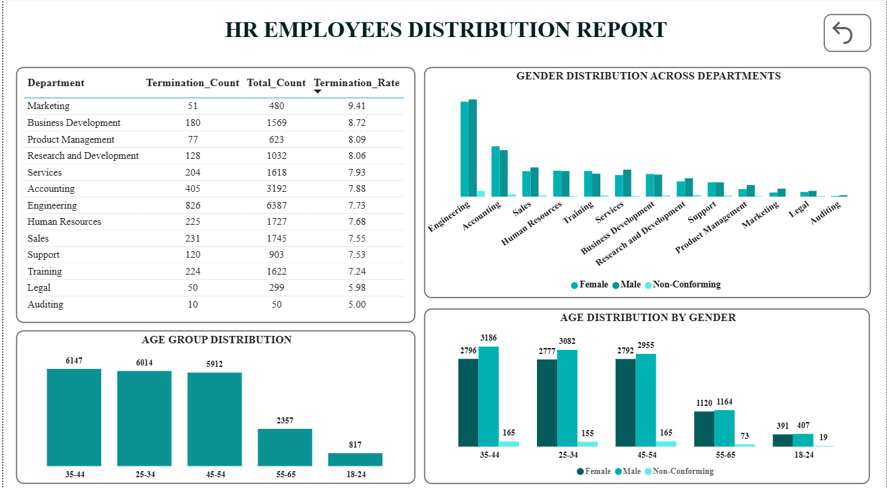

Slide 12
Department Turnover Analysis
Marketing department has the highest turnover rate at 9.41%, indicating stronger employee attrition.
Engineering has the highest employee count (6,387) but maintains a comparatively stable turnover rate (7.73%).
Auditing and Legal departments show the lowest turnover rates, reflecting better employee retention.
Gender Distribution Across Departments
Engineering and Accounting departments have the highest workforce representation across genders.
Female and male employee counts are relatively balanced in several departments.
Non-conforming employee representation remains significantly lower across all departments.
Age Group Distribution
Employees aged 35–44 form the largest workforce segment (6,147 employees).
The 25–34 and 45–54 age groups also contribute heavily to the workforce.
Young employees (18–24) represent the smallest employee segment, indicating lower entry-level workforce concentration.

Slide 13
Age Distribution by Gender
Male employees slightly outnumber female employees across most age groups.
The highest employee concentration for both genders lies within the 25–54 age range.
Non-conforming employee count remains consistently low across all age groups.
Workforce Stability Insights
Most departments maintain turnover rates between 7%–8%, showing moderate workforce stability.
The organization appears to retain mid-career employees effectively.

Slide 14
KEY INSIGHTS
Engineering has the highest employee count.
Major workforce belongs to 25–54 age group.
Remote employees form nearly 75% of workforce.
Employee growth steadily increased after 2010.
Ohio has the highest employee concentration.

Slide 15
CONCLUSION
The HR analytics project successfully transformed raw employee data into meaningful business insights using SQL and Power BI.
SQL data cleaning improved data accuracy by handling missing values, correcting date formats, and creating calculated fields for analysis.
Power BI dashboards provided interactive visualization of workforce demographics, employee growth, turnover trends, and department performance.
Employee growth increased steadily over the years, showing organizational expansion and workforce stability.
Turnover analysis highlighted departments with higher attrition, helping HR identify areas requiring improvising strategies to reduce the attrition.
Overall, the project demonstrates how data analytics can help organizations improve employee management, optimize workforce planning, and support business growth .

